Slide 1
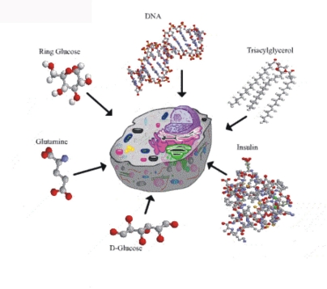
Chemical Reactions for Life!
Life Chemistry …

Slide 2
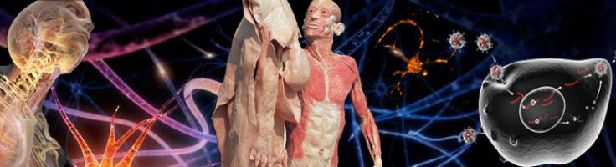
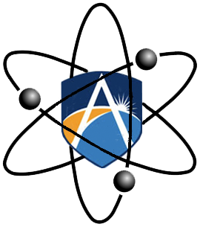
Metabolism:
Is the set of life-sustaining chemical reactions within all cell of living organisms.
These reactions allow organisms to grow and reproduce, maintain their structures, and respond to their environments.

Slide 3
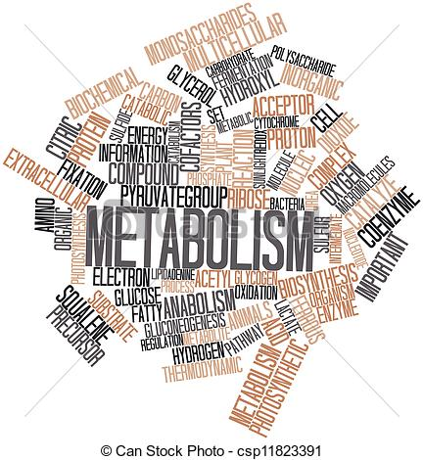
Metabolism:
The two main metabolic processes are:
Catabolism
Anabolism

Slide 4
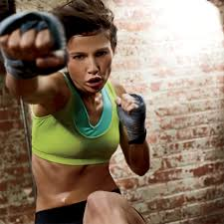
Catabolism:
Chemical reactions that break down molecules for energy.
Examples: the breakdown of fat in adipose tissue to energy.

Slide 5
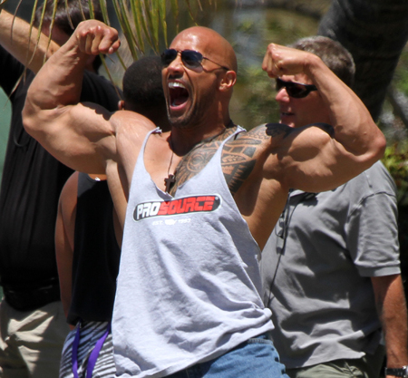
Anabolism:
Chemical reactions that construct/build molecules and this requires energy.

Slide 6
Anabolism:
This is the reverse of catabolism.
Examples are:
Building muscle.
Creating new cells.
Mineralizing bones.
Hence the term …. Anabolic STEROIDS

Slide 7
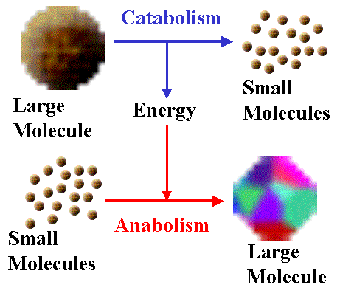

Slide 8
Respiration 1
Respiration!

Slide 9
Respiration 1
Brainstorm

Slide 10
Respiration 2
What you will learn about
in this topic:
Aerobic respiration
Anaerobic respiration
Oxygen debt

Slide 11
Respiration 3
Learning objectives
By the end of this presentation you should be able to:
Understand what respiration is
Describe the difference between aerobic and anaerobic respiration
Explain how each type of respiration works

Slide 12
Respiration 4
Respiration
Respiration is when muscles release energy in the form of glucose.
Both aerobic and anaerobic respiration convert glucose into energy.

Slide 13
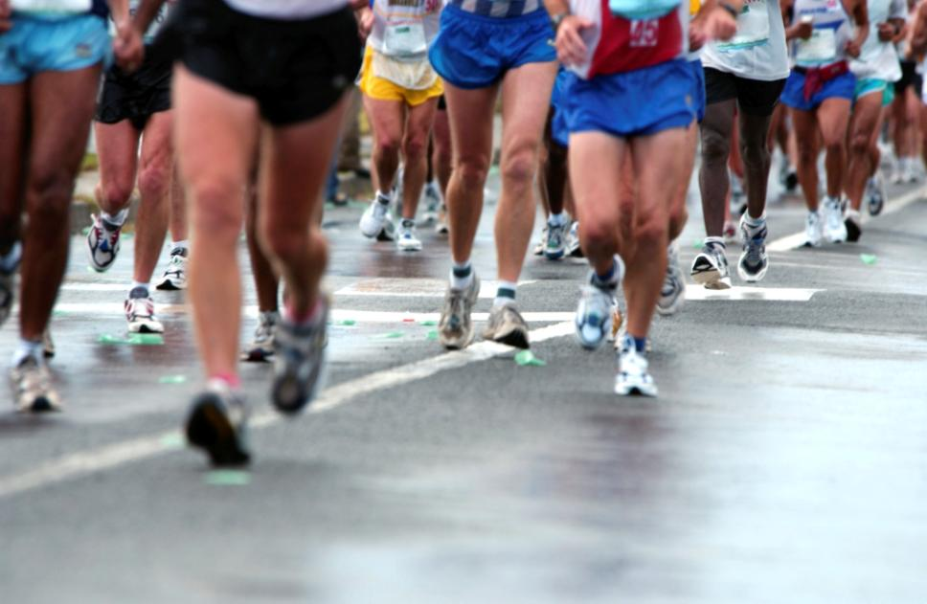
Respiration 5
The body can use both types of respiration depending on the intensity of the exercise.

Slide 14
Respiration 7
The limit to the amount of oxygen we can take in is called the VO₂ maximum.

Slide 15
Respiration 8
Aerobic respiration
During aerobic respiration your heart and lungs work to supply the muscles with oxygen.
The aerobic system is used in moderate to hard continuous activities.

Slide 16
Respiration 8
http://www.youtube.com/watch?v=j_Yk1xeSLRk

Slide 17
Respiration 9
The equation for respiration is:
glucose + O₂ →
CO₂ + H₂O + ATP

Slide 18
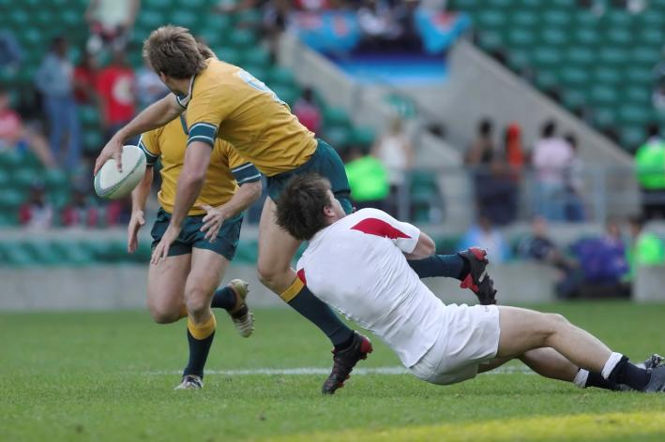
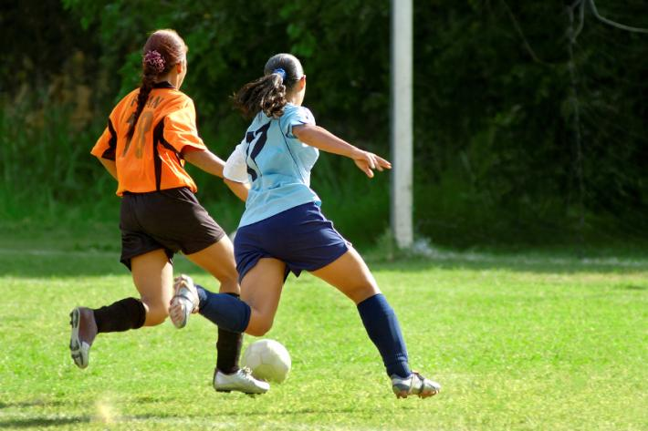
Respiration 10
As long as enough oxygen is supplied to the muscles you can use the aerobic system.

Slide 19
Respiration 11
Anaerobic respiration
During anaerobic respiration the muscles are NOT supplied with oxygen.
glucose + NO oxygen
lactic acid + ATP

Slide 20
Respiration 11
ATP
Adenosine triphosphate, or ATP, is the molecule for storing and transferring energy in cells. It is often referred to as the energy currency of the cell and can be compared to storing money in a bank.
ATP can be used to store energy for future reactions or be withdrawn to pay for reactions when energy is required by the cell.

Slide 21
Respiration 11
Anaerobic respiration
Usain Bolt
http://www.youtube.com/watch?v=By1JQFxfLMM

Slide 22
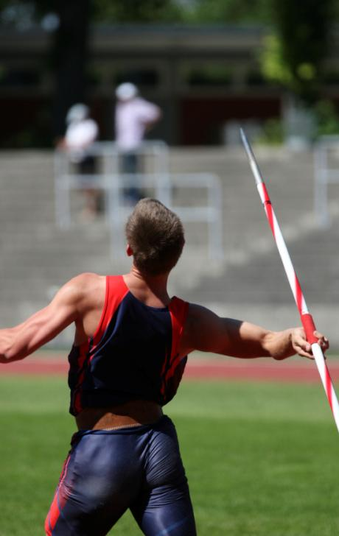
Respiration 12
Athletic field events are good examples of anaerobic exercise.
These activities use one all-out burst of maximum effort to complete the event; the time it takes to complete the attempt is very short.

Slide 23
Lactic acid
http://www.youtube.com/watch?v=BqBerM9FPwA
http://www.youtube.com/watch?v=p1UvxxYIv3U&NR=1
Lactic acid is a poison. It builds up slowly during exercise that is up to 75% of maximum work rate. During higher intensity work it builds up much more quickly.
After a while lactic acid makes the muscles ache. It will eventually cause cramp and the muscles will stop working. Athletes need to rest while the blood brings fresh supplies of oxygen.

Slide 24
Respiration 21
Exam questions
What are the two energy production systems used by the body when taking part in sport?
What sports does aerobic respiration help most effectively? Give two examples.
Notes:
Teacher’s notes
Q1
Aerobic and anaerobic respiration.
Q2
Students should provide suitable sporting examples that link to stamina and longer duration activities such as marathon runners.

